Slide 1
Objectives
To understand what hashing is and for what hashing is used.
To obtain the hash code for an object and design the hash function to map a key to an index.
To handle collisions using open addressing.
To know the differences among linear probing, quadratic probing, and double hashing.
To handle collisions using separate chaining.
To understand the load factor and the need for rehashing.

Slide 2
Why Hashing?
The preceding chapters introduced search trees. An element
can be found in
time in a well-balanced search tree.
Is there a more efficient way to search for an element in a container? This chapter introduces a technique called hashing. You can use hashing to implement a map or a set
to search, insert, and delete an element in

Slide 3
Map
A map is a data structure that stores entries. Each entry contains two parts: key and value. The key is also called a search key, which is used to search for the corresponding value. For example, a dictionary can be stored in a map, where the words are the keys and the definitions of the words are the values.
A map is also called a dictionary, a hash table, or an associative array. The new trend is to use the term map.
<key,value>
Map key to an index in HashTable

Slide 4
What Is Hashing?
If you know the index of an element in the array, you can retrieve
the element using the index in
time. So, can we store the
values in an array and use the key as the index to find the value? The answer is yes if you can map a key to an index.
The array that stores the values is called a hash table. The function that maps a key to an index in the hash table is called a hash function.
Hashing is a technique that retrieves the value using the index obtained from key without performing a search.

Slide 5
More General Kinds of Keys
But what should we do if our keys are not integers in the range from 0 to N – 1?
Use a hash function to map general keys to corresponding indices in a table.
For instance, the last four digits of a Social Security number.
0
∅
1
025-612-0001
2
981-101-0002
3
∅
4
451-229-0004
…

Slide 6
Hashing
A technique that determines an index into a table using only an entry’s search key
Hash function
Takes a search key and produces the integer index of an element in the hash table
Search key is mapped, or hashed, to the index
hashTable
0
Table_size-1
index = hash(key)

Slide 7
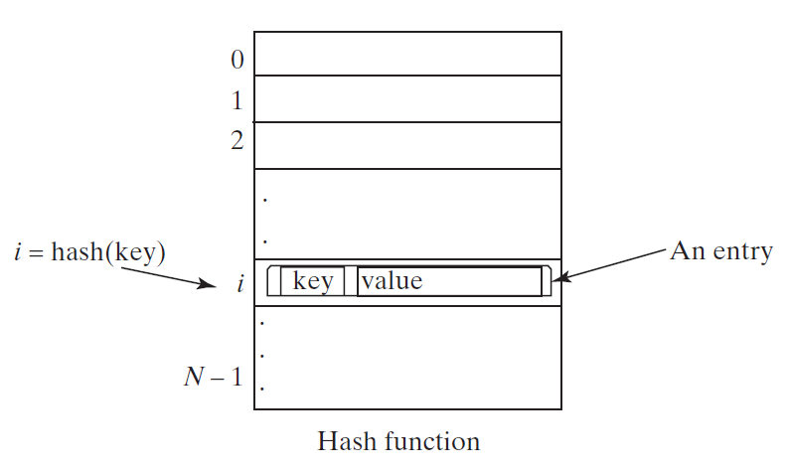
Hash Function and Hash Codes
A typical hash function:
first converts a search key to an integer value called a hash code,
Compresses the hash code into an index to the hash table.

Slide 8
Ideal Hashing
Simple algorithms for the dictionary operations that add and retrieve
put(k, v):
insert entry (k, v) into the map M; if key k is not already in M,
then return null; else, return old value associated with k
get(k): if the map M has an entry with key k, return its associated value; else, return null

Slide 9
Hash Functions and Hash Tables
A hash function h maps keys of a given type to integers in a fixed interval [0, N − 1]
Example: h(x) = x mod N is a hash function for integer keys
The integer h(x) is called the hash value of key x
A hash table for a given key type consists of
Hash function h
Array (called table) of size N
When implementing a map with a hash table, the goal is to store item (k, o) at index i = h(k)

Slide 10
Typical Hashing
Typical hash functions perform two steps:
Convert search key to an integer
Called the hash code.
Compress hash code into the range of indices for hash table.
Algorithm getHashIndex(phoneNumber)
// Returns an index to an array of tableSize elements.
i = last four digits of phoneNumber
return i % tableSize
(800)555-1234
hashCode
Index (0..table_size-1)

Slide 11
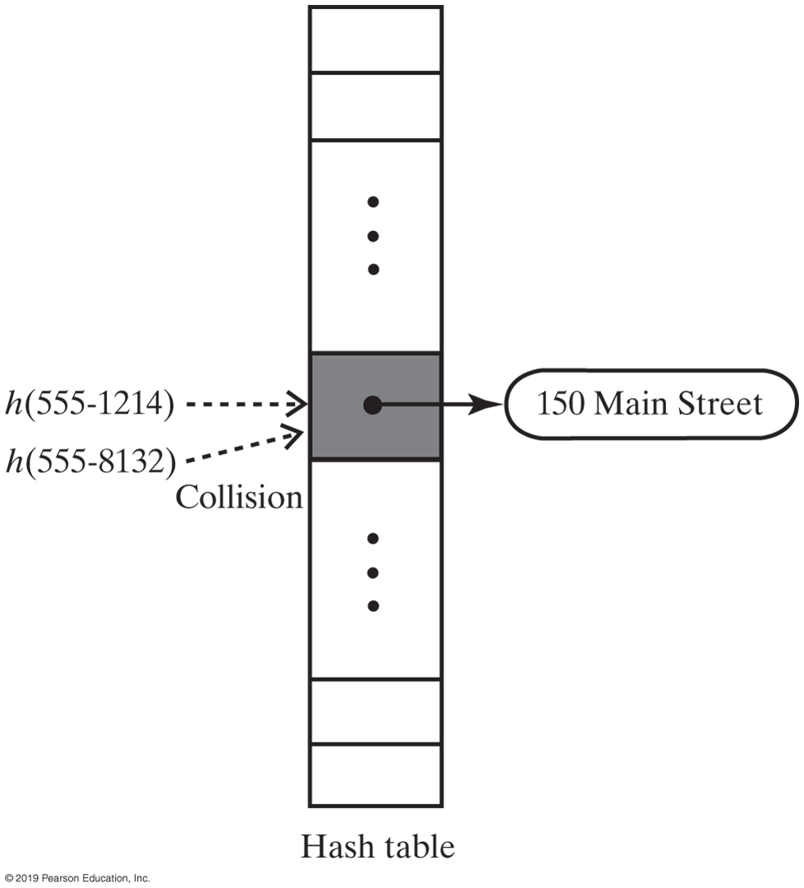
Typical Hashing
Most hash functions are not perfect,
Can allow more than one search key to map into a single index
Causes a collision in the hash table
Consider tableSize = 101
getHashIndex(555-1264) = 52
getHashIndex(555-8132) = 52 also!!!

Slide 12
Hashing
A perfect hash function
Maps each search key into a unique location of the hash table
Possible if all the search keys are known
Collisions
Occur when the hash function maps more than one item into the same array location
Collision-resolution schemes
Assign locations in the hash table to items with different search keys when the items are involved in a collision
Requirements for a hash function
Be easy and fast to compute
Place items evenly throughout the hash table

Slide 13
Computing Hash Codes
Java’s base class Object has a method hashCode that returns an integer hash code
By default returns memory address of the object
A class should define its own version of hashCode
Override: whenever the equals() method is overridden to ensure two equal objects return the same hashcode
Multiple execution of a program with same key should give same integer
Two unequal objects may have the same hashcode, must avoid too many such cases

Slide 14
A hash code for a string
Approach 1:
Using a character’s Unicode integer is common

Slide 15
Approach 2:
Generate a hash code that takes the position of characters into consideration.
Let the hash code be:
s ₀ ∗ b ^{( n − 1 )} + s ₁ ∗ b ^{( n − 2 )} + ⋯ + s _{n − 1} , where s_{i} is s.charAt(i)
The expression is a polyomial for some positive value (b).
Polynomial hash code
(…((s₀ ∗ b+s₁) ∗ b+s₂) ∗ b+⋯+s_{n−2}) ∗ b+s_{n-1}

Slide 16
Hash Code for a Primitive type
If data type is int (32 bits) → Integer.hashCode()
Use the key itself
For byte(8 bits), short(16 bits), char (16 bits):
Cast as int
For long (64 bits)
Casting from long to int (not good idea)
All keys that differ in only the first 32 bits will have the same hash code.
To take the first 32 bits into consideration (folding)
divide the 64 bits into two halves (bit-wise right-shift operator)
perform the exclusive-or operation to combine the two halves
Hash code for long key:
int hashCode = (int)(key ^ (key >> 32));

Slide 17
Other primitive types (Manipulate internal binary representations)
Hash code for float key (32 bits) → Float.hashCode():
Float.floatToIntBits(key) → Float.floatToIntBits(12.2f) → 1094923059
Float.floatToIntBits(2.2f) → 1074580685
Hash code for double key (64 bits) → Double.hashCode():
long bits = Double.doubleToLongBits(key);
int hashCode = (int)(bits ^ (bits >> 32));

Slide 18
Compressing a Hash Code
Common way to scale an integer
Use Java mod operator %: hashCode % n
Best to use a prime number for n
Prime numbers often give good distribution of hash values
Java API implementation for java.util.Map
n is set to an integer power of 2
Use logical bit-wise and (&) compress the hashCode
Index = hashCode & (n-1) → index will be in range of 0..(n-1)
n=4 , hashCode=11

Slide 19
Resolving Collisions
Collision:
Hash function maps search key into a location in hash table already in use
Two choices:
Use another location in the hash table
Change the structure of the hash table so that each array location can represent more than one value

Slide 20
Resolving Collisions
Linear probing
Resolves a collision during hashing by examining consecutive locations in hash table
Beginning at original hash index
Find the next available one
Table locations checked make up probe sequence
If probe sequence reaches end of table, go to beginning of table (circular hash table)
Possible problem
Primary clustering

Slide 21
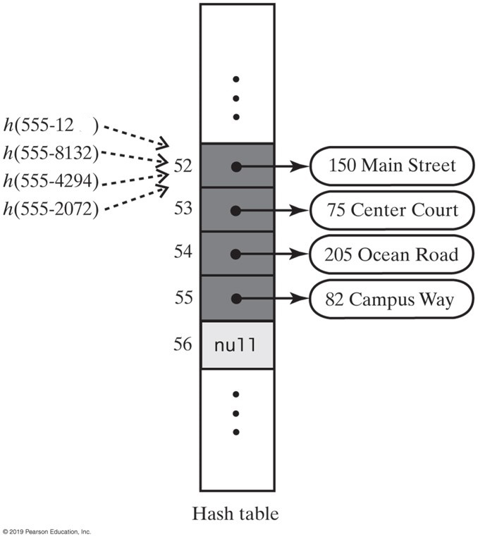
Linear Probing
64
The effect of linear probing after adding four entries whose search keys hash to the same index

Slide 22
Linear Probing
Insert 44, 4, 16, 28, 21,26 into a table of size 11
0
1
2
3
4
5
6
7
8
9
10

Slide 23
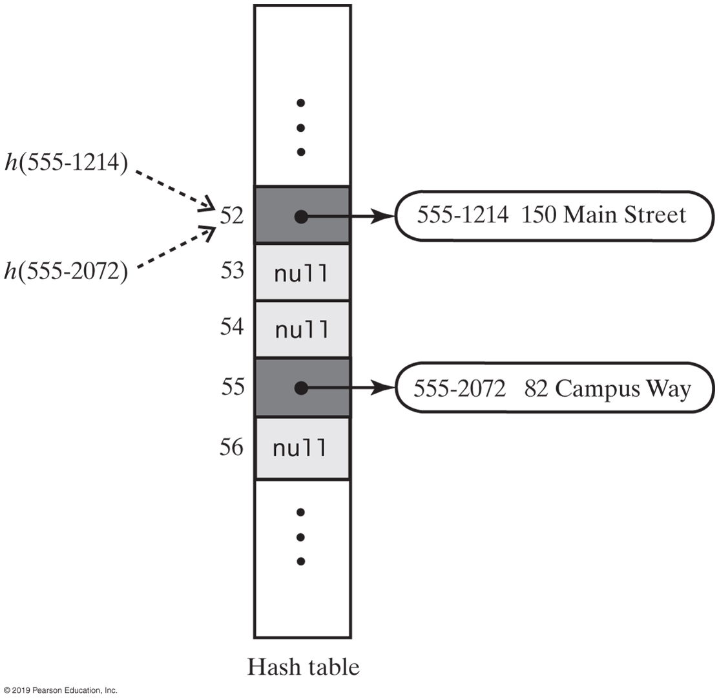
Linear Probing
6
6
Two records which got deleted
table-size = 101
A hash table if remove used null to remove entries

Slide 24
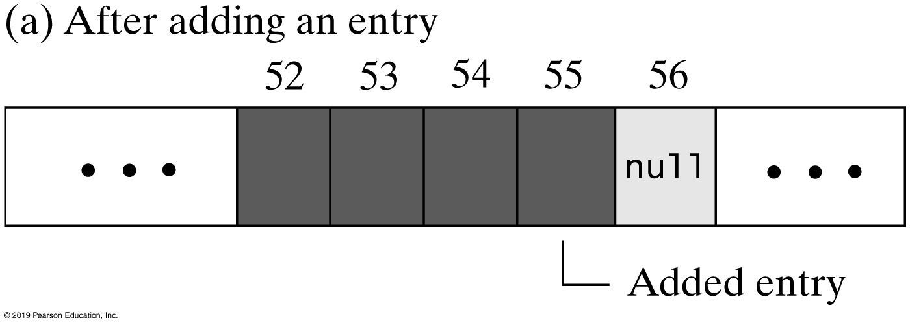
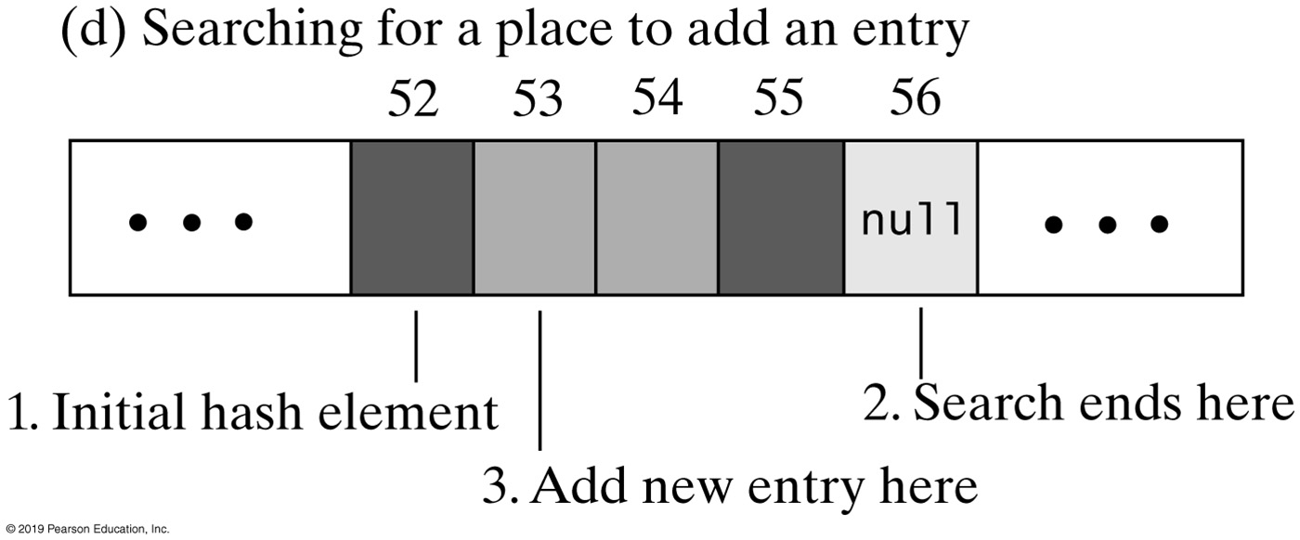
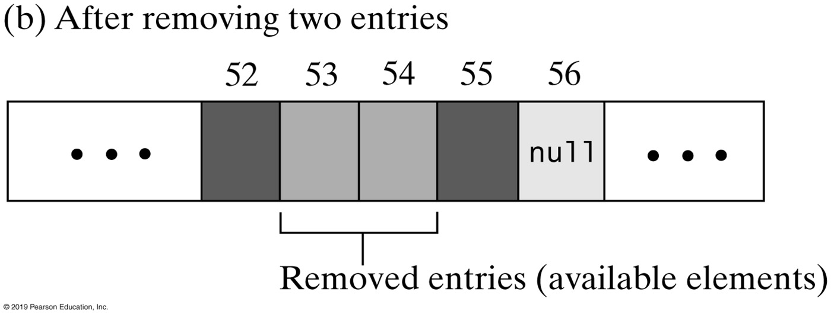
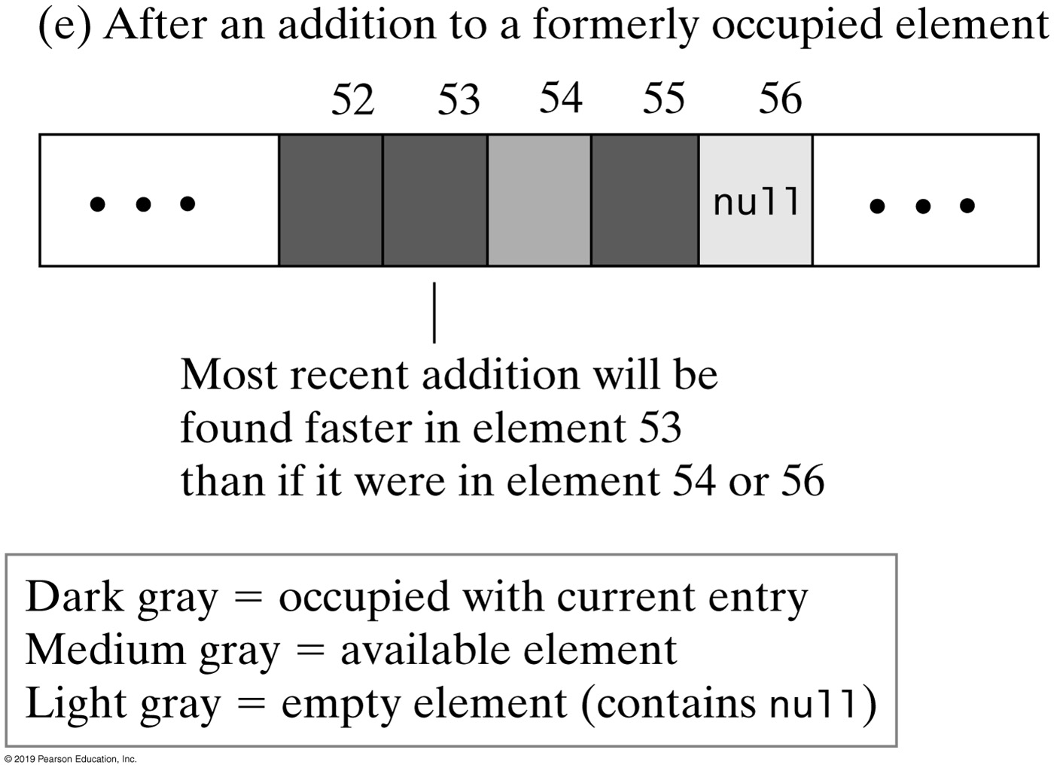
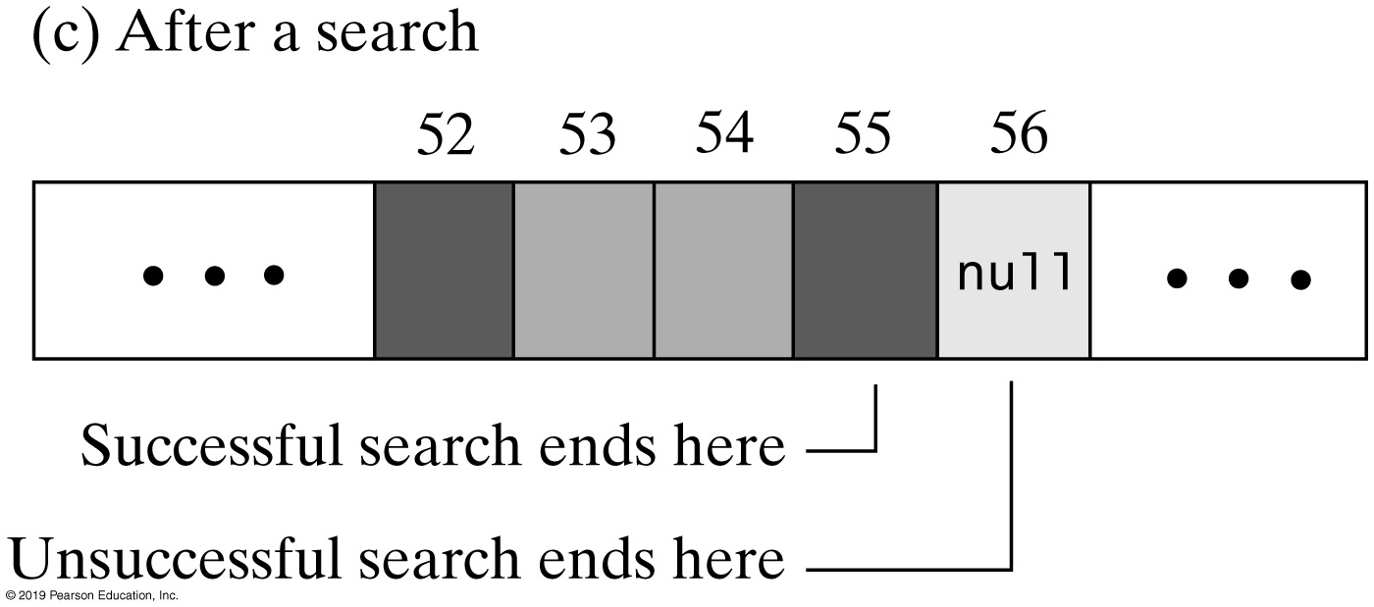
Linear Probing
Table-size=101
The linear probe sequence in various situations

Slide 25
Clustering
Collisions resolved with linear probing cause groups of consecutive locations in hash table to be occupied
Each group is called a cluster
Bigger clusters mean longer search times following collision

Slide 26
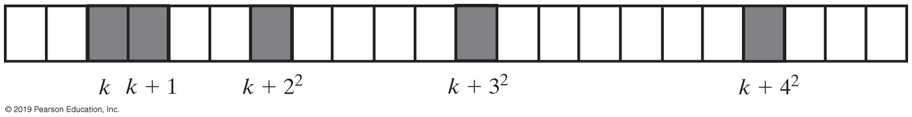
Open Addressing with Quadratic Probing
Linear probing looks at consecutive locations beginning at index k
Quadratic probing:
Considers the locations at indices k + j²
Uses the indices k, k + 1, k + 4, k + 9, …
A probe sequence of length five using quadratic probing
Possible problem:
Secondary clustering: entries that collide with an occupied entry use the same probe sequence

Slide 27
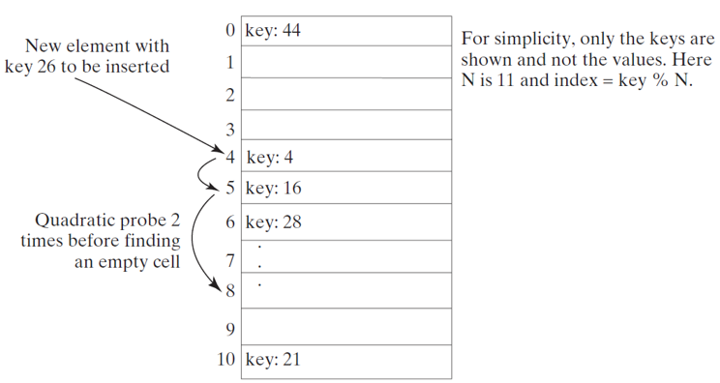
Quadratic Probing
https://liveexample.pearsoncmg.com/dsanimation/QuadraticProbingeBook.html
Quadratic probing can avoid the clustering problem in linear probing. Linear probing looks at the consecutive cells beginning at index k.
Quadratic probing increases the index by
The actual index searched are
Notes:
The section 0 has text, key, 44. Section 4 has text, key, 4. This section is labeled, new element with key 26 to be inserted. A curved arrow points from section 4 to section 5. Section 5 has text, key, 16. Section 6 has text, key, 28. A curved arrow points from section 5 to section 8. The arrow is labeled, quadratic prove two times before finding an empty cell. Section 10 has text, key, 21. The text reads, for simplicity, only the keys are shown and not the values. Here N is 11 and index = key % N.

Slide 28
Open Addressing with Double Hashing
Linear probing and quadratic probing add increments to k (initial index) to define a probe sequence
Both are independent of the search key
Double hashing is an open-addressing collision resolution technique that uses 2 different hash functions to compute bucket indices. Using hash functions h1 and h2, a key's index in the table is computed with the formula (ℎ1(key)+i∗ℎ2(key))mod(tableSize). Inserting a key uses the formula, starting with i = 0, to repeatedly search hash table buckets until an empty bucket is found. Each time an empty bucket is not found, i is incremented by 1. Iterating through sequential i values to obtain the desired table index is called the probing sequence.
This is a key-dependent method.

Slide 29
Double Hashing
Double hashing uses a secondary hash function on the keys to determine the increments to avoid the clustering problem.
k = h(key) = key % table-size
h’(key) = 7 – key % 7;
(table-size=11)
0
1
2
3
4
5
6
7
8
9
10
Insert 44, 4, 16, 28, 21,26 into a table of size 11

Slide 30
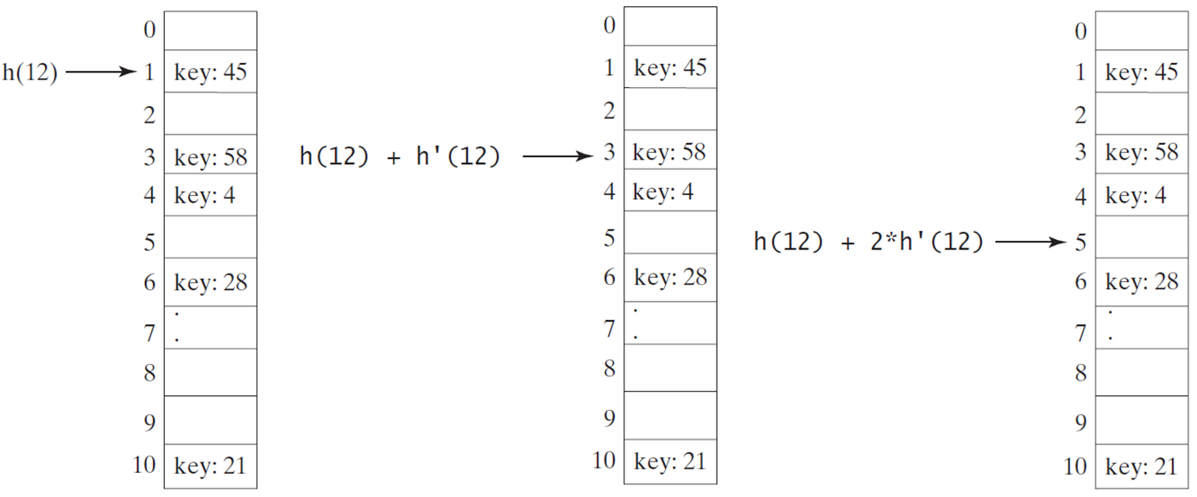
Double Hashing
https://liveexample.pearsoncmg.com/dsanimation/DoubleHashingeBook.html
Double hashing uses a secondary hash function on the keys to determine the increments to avoid the clustering problem.
Notes:
The text in various sections is as follows.
Section 1. key, 45.
Section 3. key, 58.
Section 4. key, 4.
Section 6. key, 28.
Section 10. key, 21.
All other sections are blank.
Section 1 in the first box is labeled, h left parenthesis 12 right parenthesis. Section 3 in the second box is labeled, h left parenthesis 12 right parenthesis + h dash left parenthesis 12 right parenthesis. Section 5 in the third box is labeled, h left parenthesis 12 right parenthesis + 2 times h dash left parenthesis 12 right parenthesis.

Slide 31
Potential Problem with Open Addressing
Recall each location is either occupied, empty, or available
Frequent additions and removals can result in no locations that are null
Thus searching a probe sequence will not work
Consider separate chaining as a solution

Slide 32
Resolving Collisions
Approach 2: Restructuring the hash table
Changes the structure of the hash table so that it can accommodate more than one item in the same location
Buckets
Each location in the hash table is itself an array called a bucket
Separate chaining
Each hash table location is a linked list

Slide 33
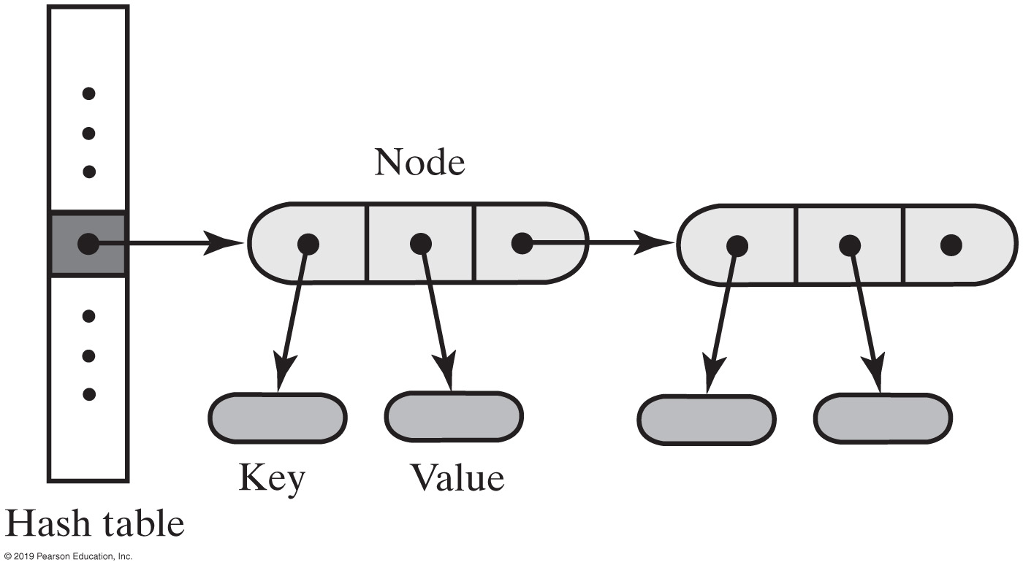
Separate Chaining
Alter the structure of the hash table
Each location can represent more than one value.
Such a location is called a bucket
Decide how to represent a bucket
list, sorted list
array
linked nodes
vector
A hash table for use with separate chaining; each bucket is a chain of linked nodes

Slide 34
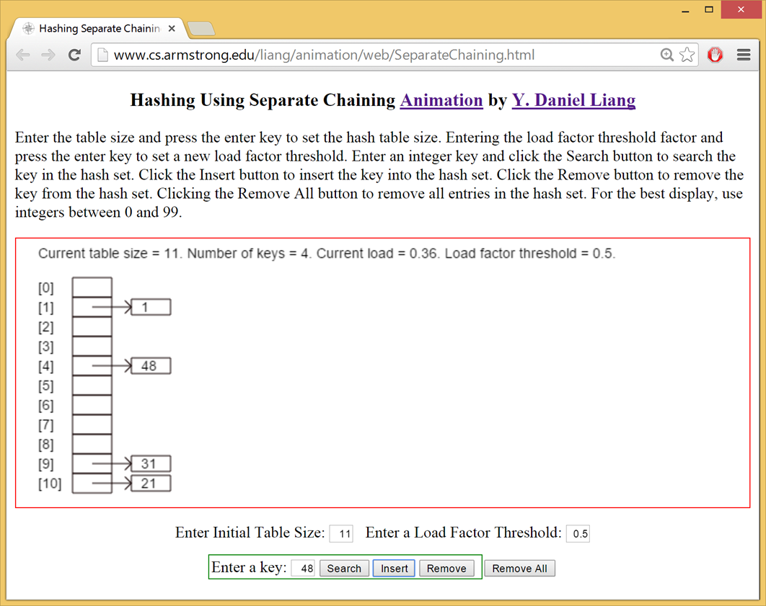
Separate Chaining Animation
https://liveexample.pearsoncmg.com/dsanimation/SeparateChainingeBook.html
Notes:
Daniel Liang
Enter the table size and press the enter key to set the hash table size. Entering the load factor threshold factor and press the enter key to set a new load factor threshold. Enter an integer key and click the Search button to search the key in the hash set. Click the Insert button to insert the key into the hash set. Click the Remove button to remove the key from the hash set. Clicking the Remove All button to remove all entries in the hash set. For the best display, use integers between 0 and 99.
Current table size = 11. Number of keys = 4. Current load, 0.36. Load factor threshold = 0.5.
0, blank. 1, 1. 2, blank. 3, blank. 4, 48. 5, blank. 6, blank. 7, blank. 8, blank. 9, 31. 10, 21.

Slide 35
The Efficiency of Hashing
An analysis of the average-case efficiency of hashing involves the load factor
Load factor α
Ratio of the current number of items in the table to the maximum size of the array table
Measures how full a hash table is
Should not exceed 2/3
Hashing efficiency for a particular search also depends on whether the search is successful
Unsuccessful searches generally require more time than successful searches

Slide 36
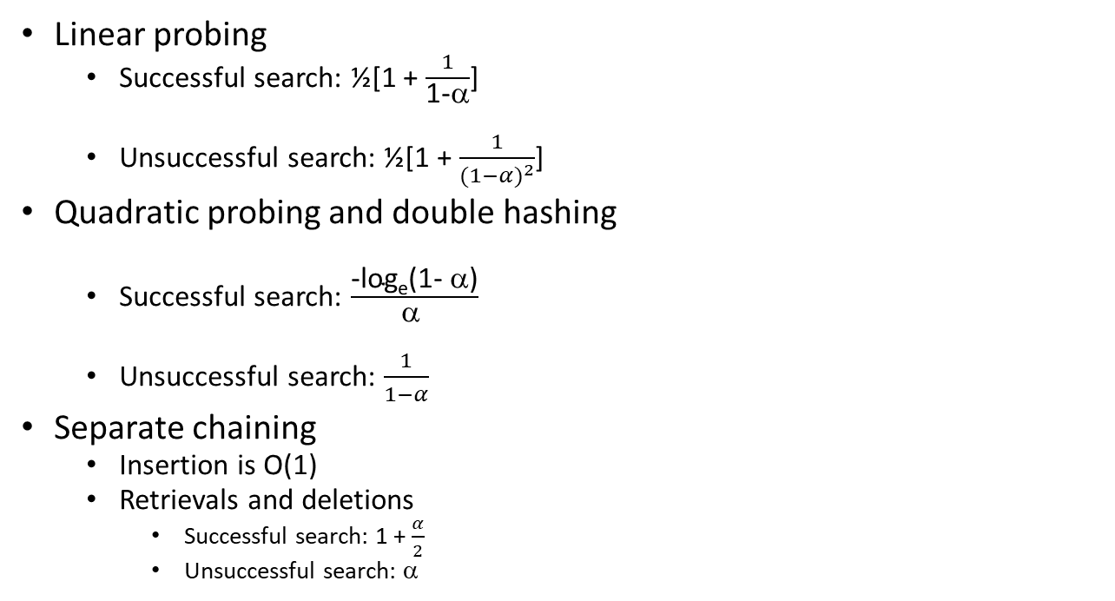
The Efficiency of Hashing
Linear probing
Successful search: ½[1 + $\frac{1}{\text{1−}\text{α}}$]
Unsuccessful search: ½[1 + $\frac{1}{{(1−α)}^{2}}$]
Quadratic probing and double hashing
Successful search: $\frac{\text{−}\text{loge}\text{(1− α)}}{\text{α }}$
Unsuccessful search: $\frac{1}{1−α}$
Separate chaining
Insertion is O(1)
Retrievals and deletions
Successful search: 1 + $\frac{α}{2}$
Unsuccessful search: α

Slide 37
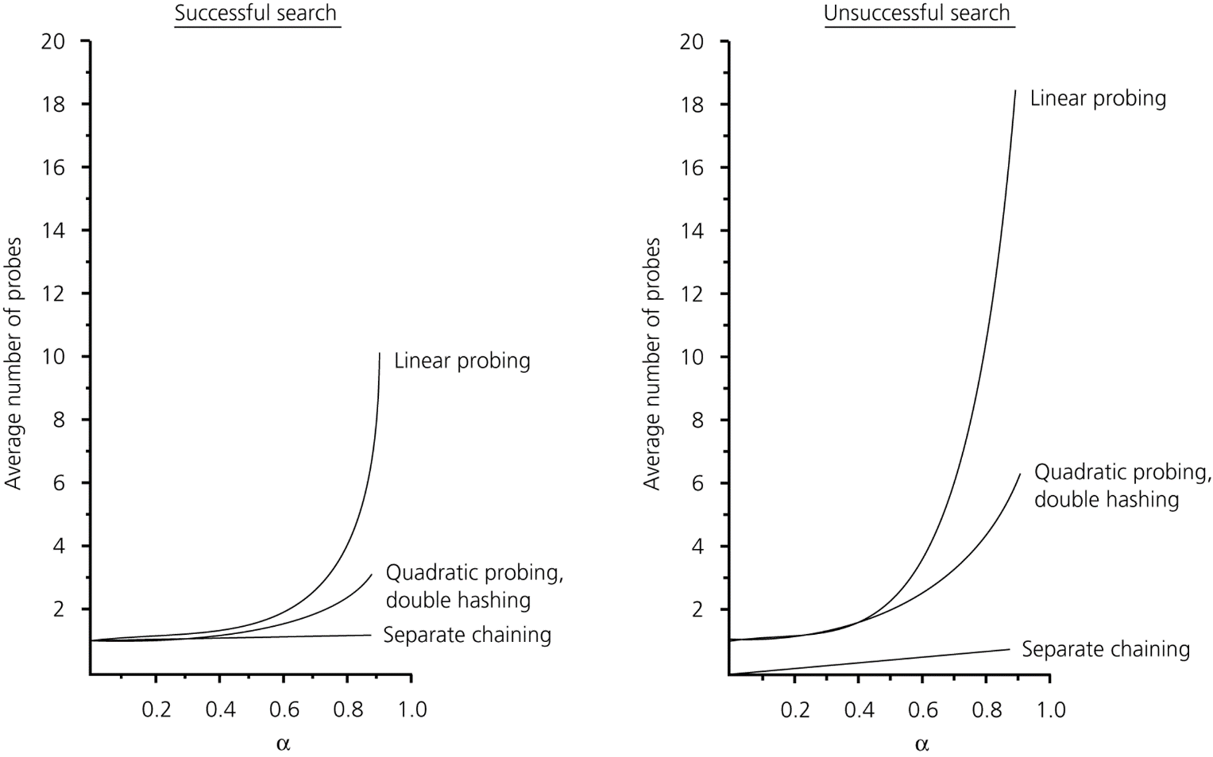
The Efficiency of Hashing
The relative efficiency of four collision-resolution methods

Slide 38
What Constitutes a Good Hash Function
A good hash function should
Be easy and fast to compute (using % or bitwise operators)
Avoid clusters : Scatter the data evenly throughout the hash table
Consider:
key → nine digits , table-size → 40, hashTable[0..39]
H(key) → (first two digits % 40)
Assume keys are unique
60 keys will map to hashTable[0..19]
40 keys will map to hashTable[20..39]
hash code

Slide 39
Java JCF HashMap provides
/** Hash function */
private int hash(int hashCode) {
return supplementalHash(hashCode) & (capacity - 1);
}
/** Ensure the hashing is evenly distributed */
private static int supplementalHash(int h) {
h ^= (h >>> 20) ^ (h >>> 12);
return h ^ (h >>> 7) ^ (h >>> 4);
}
Exclusive OR
Unsigned shift right
For example, both 11100101 & 00000111 and 11001101 & 00000111 yield 00000101. But supplementalHash(11100101) & 00000111 and supplementalHash(11001101) & 00000111 will be different. Using a supplemental function reduces this type of collision.

